Slide 1
Computer Networks (SWE3022-41)
Group
Activity #1
(2025/09/10)

Slide 2
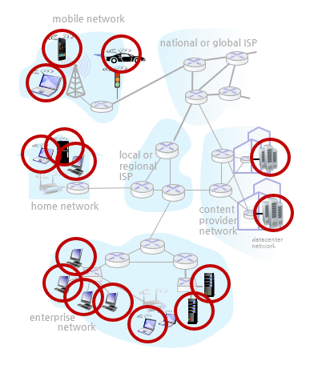
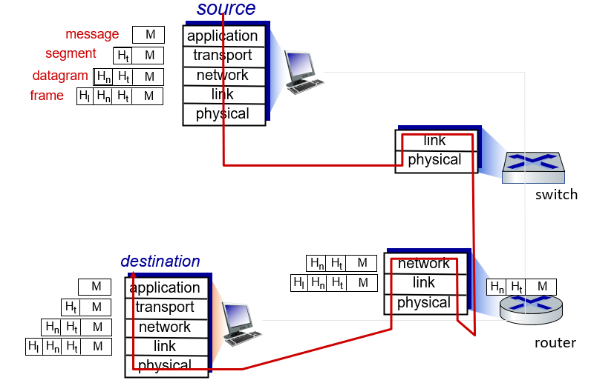
Group 1
1
Network Protocol
Explain the Internet protocol stack, and the encapsulation and the decapsulation of a user’s data by using air travel example.
Explain three examples of systems at the network edge
Compare and contrast the following access network technologies, focusing on their capabilities, limitations, and typical use cases:
Cable-based access
Digital Subscriber Line (DSL)
Wireless access networks
Notes:
2

Slide 3
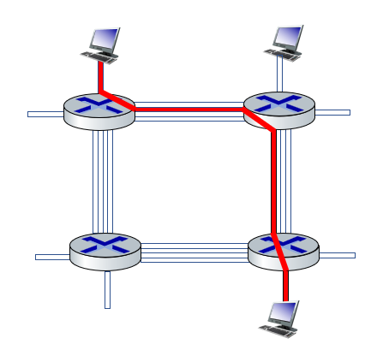
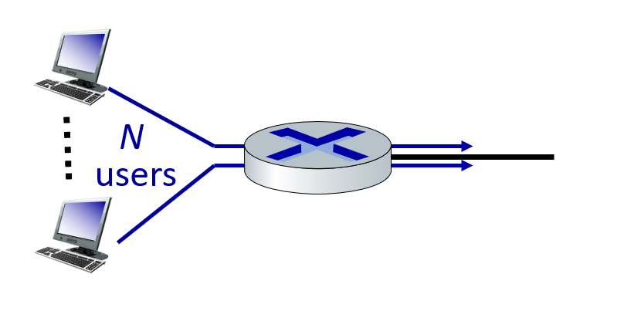
Group 2
2
Network Core
What is the packet switching? What is this method for?
Explain the keywords of the packet switching:
Store and forward
Transmission delay
End-to-end delay
Packet queuing and packet loss
Explain the differences between packet switching and circuit switching.
Resource allocation
Performance under different traffic conditions
Suitability for different types of applications
Notes:
3

Slide 4
Group 3
HyperText Transfer Protocol (HTTP)
3
Explain HyperText Transfer Protocol (HTTP).
Explain HTTP Connections such as Non-Persistent Connections and Persistent Connections.
Assume that we request first index page of www.skku.edu through web browser. The index page contains text and 12 jpeg images. Compute the fetch time of the index page in each condition listed below:
Non-persistent HTTP with serial mode
Persistent HTTP with serial mode
RTT : Round-trip time for a small packet to travel from client to server and back. One RTT is needed to initiate the TCP connection between client and server. Also, one RTT is required for both HTTP request and response.
T_file : File transmission time for index.html or jpeg image. (each jpeg image and index.html have same size)
Notes:
4

Slide 5
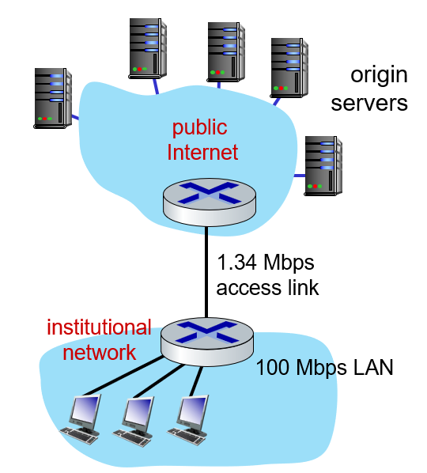
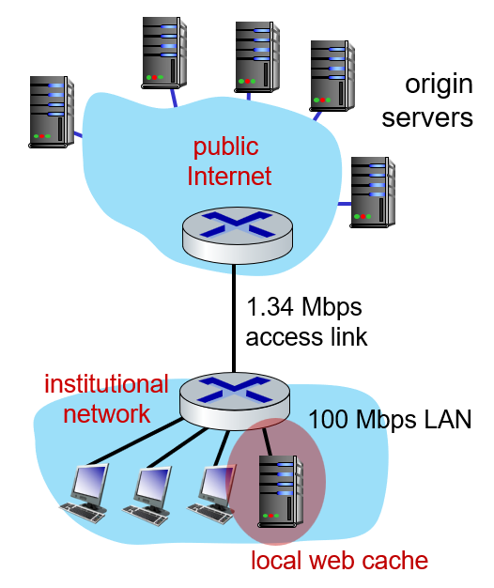
Group 4
Web Caches
4
Explain the Web Caches and its benefits.
Assuming the conditions below, calculate the following metrics:
LAN utilization
Access link utilization
Average end-to-end delay
Web object size: 100 Kbits
Avg request rate from browsers to origin servers: 12 requests/sec
Avg data rate to browsers: (12 requests/sec)*(100 Kbits/request)=1.2 Mbps
RTT from institutional router to server: 3 sec
Access link rate: 1.34 Mbps
Notes:
5

